Slide 1
Bluebonnet Learning Secondary Math: Coach Connecting Lesson Internalization and Student Work Analysis
Fernando Rosa frosa@esc1.net
Notes:
:01
Say: Welcome to today’s session: Coach Connecting Lesson Internalization and Student Work Analysis! Our focus is looking at student work within the context of Lesson Internalization.

Slide 2

Opening
We’re glad you’re here!
Please access your copies of the:
Connecting Lesson Internalization and Student Work Analysis Guided Notes
Coach Lesson Internalization Protocol
Student Work Analysis Coach Guide
Anchor lessons for our session: Grade 8 Module 4, Topic 2, Lesson 2: Systems of Equations
Begin familiarizing yourself with the lesson by reading through all of the lesson components.
We will revisit these lessons later in this session.
Notes:
:01-:02
Say: We’re so glad you’re here. As we’re getting settled, please pull up your guided notes and the anchor lesson.
Notes and Resources:
Provide participants with guided notes and a copy of the anchor lesson. This can be before the training starts as people are showing up.
Guided Notes Link: https://docs.google.com/document/d/1AH6kdXtmRghio2QP-nrkmMm-cGvSVyBM/edit?usp=sharing&ouid=107673185801282261318&rtpof=true&sd=true
Student Work Analysis Protocol Coach Guide Link: https://drive.google.com/file/d/1qKfrOhDu9gNpLMpBPAVpaIUHVuVsHL3M/view?usp=sharing
Coach Lesson Internalization Protocol Link: https://drive.google.com/file/d/1lFkESvIJYS3_ju0wjbYXdg952BoyoYky/view?usp=sharing
Anchor Lesson: Grade 8, Module 4, Topic 2 Lesson 2:https://drive.google.com/file/d/1JSBtDWWJ-kFk9ZiUmazuTq96C1PA0oab/view?usp=sharing

Slide 3




Norms for our Session
Engagement
Partnership
Curiosity
Grace
This work will support your students. Be an active participant in all learning experiences by sharing your thoughts and asking questions.
We are partners and our time is valuable. Please raise your hand and wait until others have finished their thoughts before you begin speaking.
We value your questions and will pause throughout our time together to answer questions.
Learning a new product for your subject can be challenging. You won't walk away today or even this year as experts. It's okay to walk away without a feeling of closure.
Notes:
:03
Say: Here are the norms I invite us to follow for each live session. We hope for these sessions to be filled with engagement, partnership, curiosity, and most importantly community. To ensure that we have sessions filled with these ideas, we’ve established these norms. First, please stay engaged and participate in all learning experiences. We also ask that you raise your hand to answer questions from the facilitator through the session.
Second, we want you all to feel as though you are partners in this work so if you have a question, please feel free to raise your hand. We want everyone to feel that what they think has value, so we ask that you wait for a person to finish their thoughts before speaking.
Third, please feel free to ask questions throughout our session.
Lastly, please give yourself grace and accept the lack of closure that will come from this learning journey. You won't know everything today, and that's okay. Be kind to yourself and others.
Notes:
This occurs after the HQIM Intro session so if you reviewed these norms in prior sessions, you may choose not to explain them again and instead highlight what you saw participants do well in the prior session and provide a focus area for your time together in this session
Optional edit: If you have a parking lot up for questions, you would want to name that with the curiosity norm.

Slide 4

Coach Session Objectives
During this session you will:
Describe how lesson internalization can be improved when using student data to prepare lessons with specific student strengths and progress towards mastery in mind
Identify ways to support teachers in their use of the Student Work Analysis Protocol to increase student learning
Understand how to effectively incorporate analyzing student work as part of the Lesson Internalization Protocol to improve student outcomes
Notes:
:03
Summarize and/or have participants read the 3 bullets
Say: In this session, you will connect the Student Work Analysis Protocol (SWAP) to your work with lesson internalization, as well as consider how to best support teachers in their use of the SWAP. Finally, you will explore how to help your teachers best leverage the Student Work Analysis Protocol to more effectively internalize and adjust upcoming lessons to meet the needs of all students.

Slide 5

Connecting to the Coach Competencies​
Essential Questions:
How can analyzing student work impact the way teachers internalize upcoming lessons?
How can teachers make effective, data-driven adjustments to their lessons to meet the needs of all students?
Aligned Competencies:
​Coaching Competency #1:​Understand how the HQIM product is built on a foundation of research-based instructional strategies and how it contributes to better learning outcomes for all students and can engage and invest teachers in building their own understanding of the HQIM product. ​
Coaching Competency #2:​ Establish effective collaborative planning practices that align with the local context and lead effective teacher collaborative planning sessions focused on effective HQIM practices using high-leverage protocols ​
​Coaching Competency #3:​ Accurately diagnose instructional needs based on classroom observations and analysis of student work and provide targeted and actionable feedback that leads to improved teacher and student performance. ​
Based on the objectives and essential questions, how you think this session will contribute to mastery of Competencies #1, #2, and #3?
Take 1 minute to record your response to the Guided Question in your Guided Notes.
Notes:
:04-:05
Say: Before we dive into our session, we are going to set our purpose for learning and connect to the competencies we are building as part of our professional learning. Have a participant read the essential questions and another participant read the aligned competencies. Now that we have named the purpose of our learning today, take a moment to reflect on how this session will contribute to the mastery of the aligned competency. Jot this down in your guided notes.
Notes:
If time allows, you could have participants share their thoughts with a partner.

Slide 6
Agenda - Supporting the Student Work Analysis Protocol
Introduction
Supporting the Student Work Analysis Protocol with Just-in-Time Supports
Adjusting Lessons Based on Student Work Analysis
Closing

Slide 7
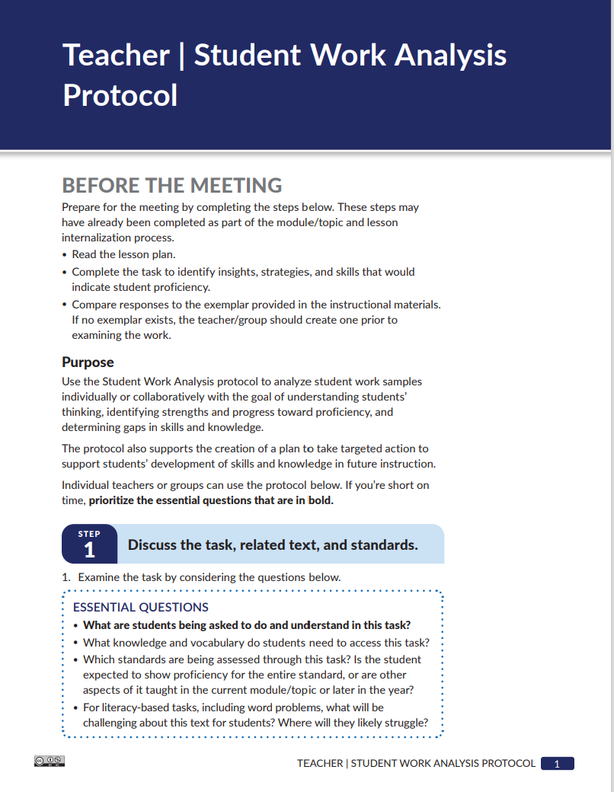
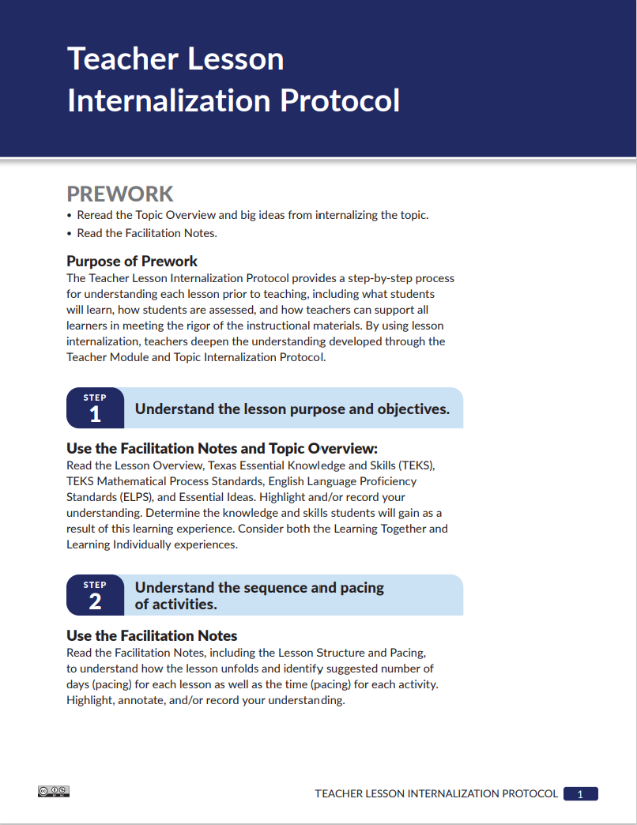

Reconnecting with the Protocols
Directions:
Take 4 minutes to review the Bluebonnet Learning Secondary Math Teacher Lesson Internalization Protocol and Teacher Student Work Analysis Protocol.
Consider and be ready to share:
How do you see these two protocols working together?
Notes:
:05-:10
Say: This session will be focused on working with the Student Work Analysis Protocol (SWAP) as a part of the lesson internalization process. You will start by reconnecting with the Lesson Internalization Protocol and the Student Work Analysis Protocol. Take 5 minutes to review the Bluebonnet Learning Secondary Math Lesson Internalization Protocol and Student Work Analysis Protocol. As you read, reflect on the following questions in your Guided Notes and be ready to share your thoughts: How have you been successful in using this protocol? What has been challenging? How can you use each step of the protocols to optimize student outcomes? After 4 minutes, have participants share their responses.
Resources:
Example answers to this question are on the next slide
Student Work Analysis Protocol Coach Guide Link: https://drive.google.com/file/d/1qKfrOhDu9gNpLMpBPAVpaIUHVuVsHL3M/view?usp=sharing
Coach Lesson Internalization Protocol Link: https://drive.google.com/file/d/1lFkESvIJYS3_ju0wjbYXdg952BoyoYky/view?usp=sharing

Slide 8
Lesson Internalization and Student Data Connections
3. Which of the following best describes the first step in effective lesson planning?
Designing a final assessment to test student knowledge
Reviewing student behavior expectations
Understanding the lesson purpose and objectives
Assigning homework to reinforce skills
Correct Answer Rationale: The correct answer is C. Understanding the lesson's purpose and objectives is the foundation of effective instruction. This step ensures that teachers are clear on what students need to learn, which allows them to anticipate misconceptions and connect the lesson to prior knowledge or developing skills. The other options, while important aspects of teaching, do not represent the first critical step in instructional planning.
Step 1: Understand the lesson purpose and objectives.
Anticipate potential student misconceptions
Identify the related skills and knowledge that students already possess or that they are still developing and adjust instruction accordingly.
Step 2: Understand the sequence and pacing of activities.
Identify activities within the lesson that might require more or less time than intended and adjust pacing accordingly. Although every lesson component must be taught every day, small pacing adjustments within the lesson components can be made.
4. Why is it important to understand the sequence and pacing of lesson activities?
So that every activity is taught for the exact same amount of time
To ensure students have homework after every lesson
To identify which activities may need more or less time and adjust pacing accordingly
So that the lesson can be taught without any changes or flexibility
Correct Answer Rationale: The correct answer is C. Understanding the sequence and pacing of activities helps educators manage instructional time effectively. Not every activity will go exactly as planned—some might take longer due to student engagement or misconceptions, while others may require less time. This awareness allows teachers to make small but necessary adjustments within the lesson to keep students on track without skipping essential components.
Step 3: Prepare to teach each activity with an activity deep dive.
Determine the need for specific product-embedded supports or extensions that will help all students be successful during the activity
Step 4: Organize your resources.
Ensure that all students will have easy access to specific materials or resources needed to support or extend their learning
By incorporating student data while completing each step of the Lesson Internalization protocol, teachers will more accurately internalize lessons.
Notes:
:10-:12
Animated Slide
Say: Now that we have taken some time to reconnect with the protocols let's take a moment and review how the Lesson Internalization Protocol is enhanced when incorporating student data. For each step, let’s look at how the protocol is strengthened by the use of student data.
Note: Click on the slide for each step to animate and have a participant read each step.

Slide 9
Just-in-Time (JIT) Supports as a Framework
Look Ahead
Assess
Action
1. How does the Just-in-Time (JIT) support framework help guide instructional planning using High-Quality Instructional Materials (HQIM)?
A. It ensures students only focus on current grade-level standards.
B. It allows teachers to skip pacing and mapping tools.
C. It helps identify upcoming skills, when they will spiral in, and what students need to succeed.
D. It encourages assigning all content at once without adjustment.
Correct Answer Rationale: The correct answer is C. The JIT framework emphasizes analyzing pacing tools and maps in HQIM to anticipate upcoming skills, determine when those skills will reappear (spiral), and identify what foundational knowledge or supports students need to be successful—making instruction timely and targeted.
What tools does your HQIM have for pacing and mapping?
What skills are next? When will those be spiraled in next?
What do students need to do to be successful at those specific skills?
What tools does your HQIM have to help you gather data on these skills and track them?
After administering your assessment, consider the adjustments and/or interventions (whole or small group) based on need shown in the data.
Implement the adjustments and/or interventions you created
Utilize HQIM tools to help implement them (embedded supports, Margin Note Boxes, language materials, accessibility features)
Notes:
:12-:14
Say – We're going to do a quick review of Just-in-Time Supports before reflecting on some scenarios depicting Lesson Adjustments with the LI and SWAP. When considering Just-in-Time supports, many teachers wonder what product-specific activities serve this purpose. It can be helpful to think about Just-in-Time supports as a framework rather than specific activities or dedicated resources. The data for every class will determine specific student needs. So thinking about Just-in-Time supports as a framework will allow you to determine what skills and knowledge are highest leverage to support meeting objectives. Considering it this way will also allow you to find Bluebonnet Learning Secondary Math resources that are available to adjust lessons/activities that can support students in meeting the objective. Have a participant read the JIT framework.

Slide 10
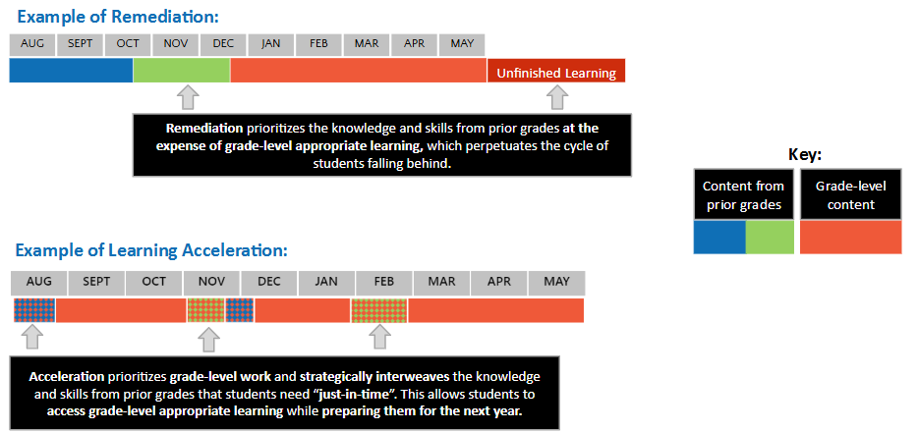
Accelerating Learning vs Remediating Learning
Notes:
:14-:16
Say: We don’t want to remediate every skill gap students have from previous grades before moving on. You can leverage data in lessons to help identify which skills your students will need to access upcoming lessons and provide strategic interventions using instructional resources. ​
This can be a whole class activity at the beginning of a lesson – such as utilizing a different a DEVELOP or Getting Started activity to provide students with additional needed practice and prepare students for the upcoming lesson concepts. It could be a short review in the middle for a whole class activity – such as incorporating foundational knowledge into the new concept to ensure students are exposed to previous skills and to see the connection with the new concept/skill. Or it can be dedicated intervention time with a small group where the teacher is providing intentional practice in foundational skills that align to the current concept being taught. ​
​

Slide 11

Just-in-Time Supports In Bluebonnet Learning Secondary Math
Concepts are continuously spiraled, creating space for just-in-time support in upcoming lessons.
Teachers can look ahead to upcoming lessons to stamp knowledge and scaffold questions.
Lesson activities and Questions to Support Discourse help teachers monitor student understanding in real time. Based on this data, teachers can adjust instruction by assigning targeted Skills Practice sets and scheduling Learning Individual days to support or extend learning.
Performance Tasks offer another opportunity to demonstrate TEKS mastery and engage with mathematical process standards.
  5. What is the main purpose of using Just-in-Time (JIT) supports during a lesson?
To reteach the entire lesson from the beginning
To implement adjustments and interventions exactly as planned, regardless of student needs
To provide timely supports using available tools to meet student needs in the moment
To skip lesson components that are too difficult for students
Correct Answer Rationale: The correct answer is C. Just-in-Time (JIT) supports are meant to be responsive—teachers use them during instruction to address student needs as they arise. This might include using high-quality instructional materials (HQIM) like embedded supports, margin notes, or accessibility features to help students engage with the content without delaying the lesson. It’s not about re-teaching everything or skipping difficult parts, but about making real-time, strategic adjustments that keep all students on track.
Notes:
:16-:17
Say – In order to do this effectively though, it's important for you to internalize what product-specific resources are available to craft those interventions. These will help you determine the method, the resource, and the pacing of these Just-in-Time Supports. Let’s review what resources are available in Bluebonnet Learning Secondary Math to support Just-in-Time learning. Have a participant read the bullet points. All of these supports can assist teachers in lesson adjustments based on student data.

Slide 12
Lesson Adjustment Guidelines
Is the adjustment grounded in specific student data?
Did you complete the SWAP before suggesting this adjustment?
What data did you use to guide this adjustment?
Did you choose the highest leverage data point to respond to?
2. Which of the following best describes a successful lesson adjustment?
A. It is made quickly to keep the lesson on schedule.
B. It uses student data and supports all learners while staying true to the high-quality instructional materials (HQIM).
C. It focuses only on the highest-performing students to ensure challenge.
D. It significantly alters the HQIM to better match teacher preference.
Correct Answer Rationale: The correct answer is B. A successful lesson adjustment is grounded in specific student data, helps students meet lesson objectives, maintains fidelity to HQIM, and addresses the needs of all students, including emergent bilingual students and students with IEPs. This ensures equity, effectiveness, and alignment with instructional goals.
Will the adjustment improve students’ capacity to meet the objectives of the upcoming lesson?
Is the adjustment being made to an activity that closely aligns to the lesson objective and/or formative assessment?
Does the adjustment add to students’ learning without removing other essential learning?
Will the adjustment maintain fidelity to the HQIM?
Does the adjustment only involve the materials provided in Bluebonnet Learning Secondary Math?
Does the adjustment maintain the overall design and pacing of Bluebonnet Learning Secondary Math?
Will the adjustment address the needs of the whole class as well as specific subpopulations? (including Emergent Bilingual students and students with IEPs).
Have you considered additional supports that may be needed as part of this adjustment?
Is the adjustment “one size fits all”?
Notes:
:17-:19
Say: An essential goal of analyzing student work is using the action steps (as determined in Step 5 of the SWAP) to make meaningful adjustments to upcoming lessons. This connects directly to the work done in Step 3 of the Lesson Internalization Protocol: “Prepare to teach each activity with an activity deep dive”. Let’s look at the guidelines for a successful, data-driven lesson adjustment. In the next section, you will engage with two different scenarios to practice determining the efficacy of teachers’ lesson adjustments.
On the slide, you’ll find the four guidelines for effective lesson adjustments and guidance around each one. If all four of these are present in your lesson adjustment, then you can feel confident in both its efficacy and ability to accelerate learning for all students. You will continue to come back to these criteria as you review the scenarios in the next section.
Note: ask a volunteer to read each guideline with the additional guidance.

Slide 13









Asset-Based Approach Examples
Asset-Based Approach Non-Examples
Students CAN do
Looking for gaps in skill sets
Celebrating the skills
Expressing frustration towards students
Seeing opportunities for growth
Seeing what students cannot do YET as a sign of failing on their part or yours
Honoring diversity of learners
Build upon positive student data
Notes:
:19-:20
Say: Before diving into the scenarios, we want to remember that having an asset-based approach is an essential part of successful student work analysis. By focusing on what students can do and using that as your guide towards what they cannot do yet, teachers open themselves and their students up to lesson adjustments that come from a place of support and acceleration, as opposed to remediation. Let’s look at what an asset-based approach is vs what is is not. Having an Asset Based approach is Looking first and foremost at what students CAN do, celebrating the skills that students have already mastered, seeing what students cannot do YET as an opportunity for growth, honoring the diversity of learners in your classroom and finding ways to build upon the positive trends you are seeing in student data. Not having an asset based approach is Immediately looking for the gaps in students’ skill sets. Expressing frustration towards students who have not yet mastered certain skills and seeing what students cannot do YET as a sign of failing on their part or yours.
Note: A different participant can read each bullet point or the same participant can read all of them for each side of the slide.

Slide 14
Agenda - Adjusting Lessons Based on Student Work Analysis
Introduction
Supporting the Student Work Analysis Protocol
Adjusting Lessons Based on Student Work Analysis
Closing
Notes:
:20
20 min mark
Say: You have now spent time with both the Lesson Internalization Protocol and the SWAP. In this section, you will anchor yourself in an upcoming Bluebonnet Learning K-5 Math lesson and then review several scenarios of teachers adjusting upcoming lessons based on their data analysis. You will learn about the Lesson Adjustment Guidelines for effective lesson adjustment and consider the efficacy of the adjustments in each scenario.

Slide 15
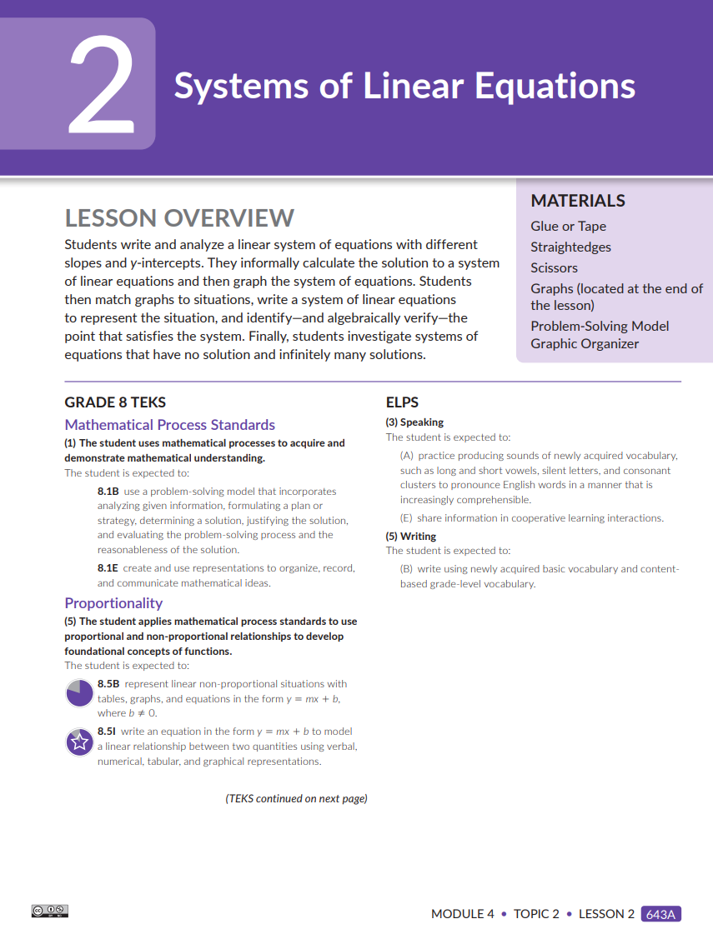
Anchor in a Lesson
Directions
Open Grade 8 Module 4, Topic 2, Lesson 2: Systems of Equations
Take 5 minutes to read through the lesson, using the questions below to guide you.
Consider and be ready to share
  What should students know and be able to do by the end of the lesson?
  What are the most critical aspects of the lesson that will lead all students to achieve mastery of its objectives?
Notes:
:20-:30
Say: To support your practice in determining the efficacy of lesson adjustments, you will first anchor yourself in a sample lesson from Bluebonnet Learning Secondary Math. As you read, reflect on the following questions in your Guided Notes. What should students know and be able to do by the end of the lesson? What are the most critical aspects of the lesson that will lead all students to achieve proficiency of its objectives? Give participants 5 min to work and 2 min to share
Resources:
Anchor Lesson: Grade 8, Module 4, Topic 2 Lesson 2:https://drive.google.com/file/d/1JSBtDWWJ-kFk9ZiUmazuTq96C1PA0oab/view?usp=sharing

Slide 16

Lesson Adjustment Scenario 1
A math teacher you know is preparing to teach a lesson and has reflected on the data they gathered from the previous lesson formative assessment. In the internalization meeting with their grade level, they mention that the formative assessment data shows that most students struggle to use equations to determine when lines have one, no, or infinitely many solutions.
Based on that data, the teacher says they will remove the next lesson because students have proven that they "aren't ready for it" and need more time to practice this skill. Since this is an integral part of systems of linear equations mathematics and the next lesson, it would be too much work to adapt, so the teacher plans to replace it with a series of worksheets. The worksheets will reteach this concept. The teacher shares that these worksheets were practical last year, so they know they will help students master the standards. The teacher wonders if this plan is right and asks for your opinion.
Consider and be ready to share:
Is the adjustment grounded in specific student data?
Will the adjustment improve students’ capacity to meet the objectives of the lesson?
Does the adjustment maintain fidelity to the HQIM?
Does the adjustment address the needs of the whole class as well as specific subpopulations?
In your Guided Notes, outline the feedback that you would give the teacher based on the Lesson Adjustment Guidelines.
Notes:
:30-:35
Say: Let’s practice applying the Lesson Adjustment Guidelines by looking at the scenario. Have a volunteer read the scenario
Using the question prompts on the screen, take 3 minutes to consider independently if the teacher’s proposed lesson adjustment is effective and plan your feedback to that teacher. Then be prepared to share.
Notes: Give participants 3 min to consider independently, then vary sharing delivery based on appropriate audience.

Slide 17
Scenario #1 Reflections
Is the adjustment grounded in specific student data?
No
The statement that "most students are struggling to use equations to determine when lines have one solution, no solution, or infinitely many solutions" indicates that the teacher may have assessed the correct root misconception, however, the adjustment focuses on separate practice of this skill instead of integration of the practice for conceptual learning.
Will the adjustment improve students’ capacity to meet the objectives of the upcoming lesson?
No
The teacher’s decision to eliminate a core activity from the upcoming lesson and instead fully reteach a part of a previous lesson will steer students away from mastering the intended objectives of the upcoming lessons.
Does the adjustment maintain fidelity to the HQIM?
No
The teacher’s decision to eliminate a core activity from the upcoming lesson and instead fully reteach a part of a previous lesson with an alternate worksheet does not maintain fidelity to the HQIM’s intended design.
Does the adjustment address the needs of the whole class as well as specific subpopulations?
No
The teacher’s decision to eliminate a core activity potentially removes a critical scaffold, which could inhibit students’ ability to achieve mastery of the lesson objective.
Notes:
animated slide
:35-:40
Say: Let’s go back to the Lesson Adjustment Guidelines and discover if the adjustments made in the scenario support effective lesson adjustments.
Note: CLICK and have a volunteer read each reflection.

Slide 18
Lesson Adjustment Scenario 2
Another math teacher in the meeting taught the same lesson earlier. This teacher has a practice of taking quick notes on how students do during the lesson. They noticed that 10 out of 18 students used graphs to determine when lines had no solution, one solution, or infinitely many solutions.
Based on this analysis, the teacher anticipates that the students will need additional support during the next lesson because, in the lesson, students must compare equations to determine if they have no solution, one solution, or infinitely many solutions. They’d like to start by emphasizing the relationships between slopes and equations with no solution and one solution and having students engage in “turn and talks” to explain their thinking. Then, they will emphasize relationships between slopes and initial values to support students as they determine which equations have infinitely many solutions. The teacher believes this will help students move from the conceptual graph to understanding abstract relationships between equations.
The teacher wonders if this plan is right and asks for your opinion.
Consider and be ready to share:
Is the adjustment grounded in specific student data?
Will the adjustment improve students’ capacity to meet the objectives of the lesson?
Does the adjustment maintain fidelity to the HQIM?
Does the adjustment address the needs of the whole class as well as specific subpopulations?
In your Guided Notes, outline the feedback that you would give the teacher based on the Lesson Adjustment Guidelines.
Notes:
:40-:45
Say: Let’s practice applying the Lesson Adjustment Guidelines by looking at another scenario. Have a volunteer read the scenario
Again, using the question prompts on the screen, take 3 minutes to consider independently if the teacher’s proposed lesson adjustment is effective and plan your feedback to that teacher. Then be prepared to share.
Notes: Give participants 3 min to consider independently, then vary sharing delivery based on appropriate audience.

Slide 19
Scenario #2 Reflections
Is the adjustment grounded in specific student data?
Yes
The teacher gathered formative data during the lesson. They could speak to the exact number of students, their strengths, and their specific areas of need.
Will the adjustment improve students’ capacity to meet the objectives of the upcoming lesson?
Yes
The teacher’s decision to add a brief just-in-time support that targets students’ misunderstanding from is an effective way of supporting all students to meet the objectives of the upcoming lesson.
Does the adjustment maintain fidelity to the HQIM?
Yes
The teacher’s decision to add in a brief just-in-time support is directly in service of helping all students meet the objectives of the upcoming lesson. While it will require the teacher to adjust activities and pacing recommendations slightly, it does not significantly deviate from the intended design or pacing of the HQIM.
Does the adjustment address the needs of the whole class as well as specific subpopulations?
Yes
The teacher's use of turn and talks supports the engagement of all students.
Notes:
animated slide
:45-:50
Say: Let’s go back to the Lesson Adjustment Guidelines and discover if the adjustments made in the scenario support effective lesson adjustments.
Note: CLICK and have a volunteer read each reflection.

Slide 20
Agenda - Closing
Introduction
Supporting the Student Work Analysis Protocol with Just-in-Time Supports
Adjusting Lessons Based on Student Work Analysis
Closing
Notes:
:50
50 min mark
Let’s close out our time together by synthesizing the learning.

Slide 21
Synthesize Your Learning
Consider what we’ve learned about asset-based mindset and incorporating student data while completing each step of the Lesson Internalization Protocol and answer the Guiding Questions:
How can analyzing student work impact the way teachers internalize upcoming lessons?
How can teachers make effective, data-driven adjustments to their lessons to meet the needs of all students?
Notes:
:50-:55
I’d like you to consider these questions as you synthesize your learning. Read the questions on the slide. Take a few minutes to consider your own practices in your classroom and reflect on the essential questions. You can jot your ideas down in your Guided Notes. Pause for 2 min for reflection. If time allows, ask for volunteers to share their reflections to one of the questions.

Slide 22

Next Steps
Complete the following tasks using your learning today:
  Exit Ticket
  Task 1
  Task 2
For general questions, please contact Name at email address.
Exit Ticket
Notes:
Notes:
Insert any important links in the slide. This can specific next steps, tasks, etc. If you have a facilitation survey, include that information as well.
Contact Information for session questions should be provided. Also share any other resources that may also be available like an FAQ, Office Hours, newsletters, etc.
If you know the next date and time of your next session(s) with this audience, please include those dates and times as well.
Exit Ticket
Recommend timing=5-10 min
Link: https://tea.co1.qualtrics.com/jfe/form/SV_bPGKD7iowqkf4ou
Note: You can choose to give participants 10 minutes to complete the exit ticket independently by adding to the guided notes or creating a separate document. The questions, answers, and rationale are included below in the slides just in case you want to review the exit ticket after giving it or use the questions to stamp key ideas at the end of the session. If you choose to review the questions, answers and rationale included in the slides with participants, please ensure the Exit Ticket link has been utilized first.

Slide 23
Exit Ticket
Notes:
Exit Ticket
Recommend timing=5-10 min
Link: https://tea.co1.qualtrics.com/jfe/form/SV_bPGKD7iowqkf4ou
Note: You can choose to give participants 10 minutes to complete the exit ticket independently by adding to the guided notes or creating a separate document. The questions, answers, and rationale are included below in the slides just in case you want to review the exit ticket after giving it or use the questions to stamp key ideas at the end of the session. If you choose to review the questions, answers and rationale included in the slides with participants, please ensure the Exit Ticket link has been utilized first.

Slide 24
Exit Ticket Part 1
1. How does the Just-in-Time (JIT) support framework help guide instructional planning using High-Quality Instructional Materials (HQIM)?
A. It ensures students only focus on current grade-level standards.
B. It allows teachers to skip pacing and mapping tools.
C. It helps identify upcoming skills, when they will spiral in, and what students need to succeed.
D. It encourages assigning all content at once without adjustment.
Correct Answer Rationale: The correct answer is C. The JIT framework emphasizes analyzing pacing tools and maps in HQIM to anticipate upcoming skills, determine when those skills will reappear (spiral), and identify what foundational knowledge or supports students need to be successful—making instruction timely and targeted.
2. Which of the following best describes a successful lesson adjustment?
A. It is made quickly to keep the lesson on schedule.
B. It uses student data and supports all learners while staying true to the high-quality instructional materials (HQIM).
C. It focuses only on the highest-performing students to ensure challenge.
D. It significantly alters the HQIM to better match teacher preference.
Correct Answer Rationale: The correct answer is B. A successful lesson adjustment is grounded in specific student data, helps students meet lesson objectives, maintains fidelity to HQIM, and addresses the needs of all students, including emergent bilingual students and students with IEPs. This ensures equity, effectiveness, and alignment with instructional goals.
3. Which of the following best describes the first step in effective lesson planning?
Designing a final assessment to test student knowledge
Reviewing student behavior expectations
Understanding the lesson purpose and objectives
Assigning homework to reinforce skills
Correct Answer Rationale: The correct answer is C. Understanding the lesson's purpose and objectives is the foundation of effective instruction. This step ensures that teachers are clear on what students need to learn, which allows them to anticipate misconceptions and connect the lesson to prior knowledge or developing skills. The other options, while important aspects of teaching, do not represent the first critical step in instructional planning.
Notes:
Facilitator Note: Ideal time to review is 2 minutes per question. This gives time to name the question, right answer, and rationale for the correct answer. You can adjust timing as needed based on how you decide to administer the exit ticket or check for understanding. Remove green highlighting to show correct answer and correct answer rationale if you use as a live review rather than exit ticket.

Slide 25
Exit Ticket Part 2
4. Why is it important to understand the sequence and pacing of lesson activities?
So that every activity is taught for the exact same amount of time
To ensure students have homework after every lesson
To identify which activities may need more or less time and adjust pacing accordingly
So that the lesson can be taught without any changes or flexibility
Correct Answer Rationale: The correct answer is C. Understanding the sequence and pacing of activities helps educators manage instructional time effectively. Not every activity will go exactly as planned—some might take longer due to student engagement or misconceptions, while others may require less time. This awareness allows teachers to make small but necessary adjustments within the lesson to keep students on track without skipping essential components.
  5. What is the main purpose of using Just-in-Time (JIT) supports during a lesson?
To reteach the entire lesson from the beginning
To implement adjustments and interventions exactly as planned, regardless of student needs
To provide timely supports using available tools to meet student needs in the moment
To skip lesson components that are too difficult for students
Correct Answer Rationale: The correct answer is C. Just-in-Time (JIT) supports are meant to be responsive—teachers use them during instruction to address student needs as they arise. This might include using high-quality instructional materials (HQIM) like embedded supports, margin notes, or accessibility features to help students engage with the content without delaying the lesson. It’s not about re-teaching everything or skipping difficult parts, but about making real-time, strategic adjustments that keep all students on track.
Notes:
Facilitator Note: Ideal time to review is 2 minutes per question. This gives time to name the question, right answer, and rationale for the correct answer. You can adjust timing as needed based on how you decide to administer the exit ticket or check for understanding. Remove green highlighting to show correct answer and correct answer rationale if you use as a live review rather than exit ticket.

